Slide 1




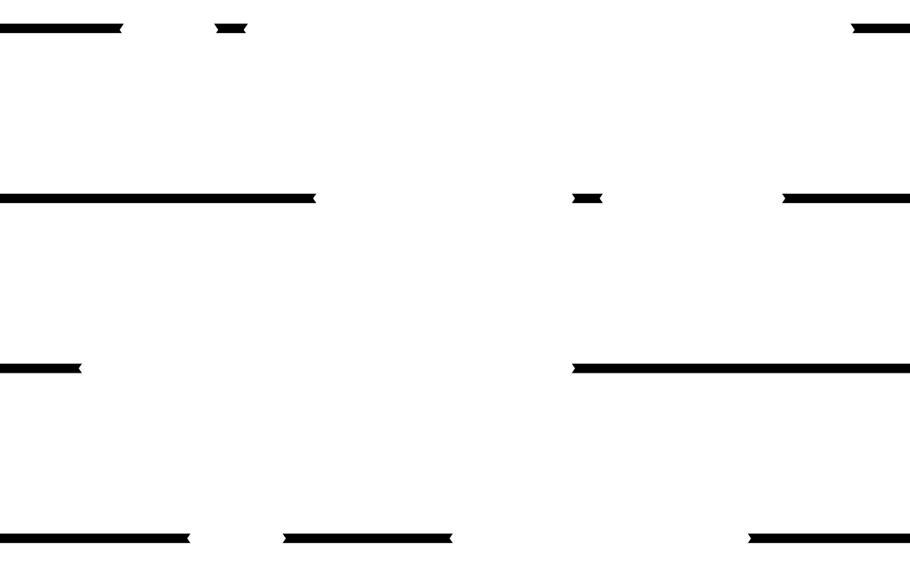
GLA UNIVERSITY
OBJECT DETECTION
FIELD PROJECT
MEMBERS NAME:
MENTOR:
ANURAG(2315000383)
SHIVAM(2315002068)
NAMAN(2315001425)
SHUBHI(2315002149)
SHAGUN(2315002022)
SARTHAK(2315001988)
MR. PIYUSH VASHISTHA
ASSISTANT PROFESSOR
CEA
DATE:-14 dec 2023

Slide 2
OBJECT DETECTION
FIELD PROJECT
PRESENTED BY:
SUPERVISED BY :
ANURAG(2315000383)
SHIVAM(2315002068)
NAMAN(2315001425)
SHUBHI(2315002149)
SHAGUN(2315002022)
SARTHAK(2315001988)
MR. PIYUSH VASHISTHA
ASSISTANT PROFESSOR
CEA

Slide 3

TABLE CONTENT
Introduction
Application
Objectives
Implementation of image detection
Methodology
Results
Future Work
Conclusion
Acknowledgements
References/Bibliography

Slide 4
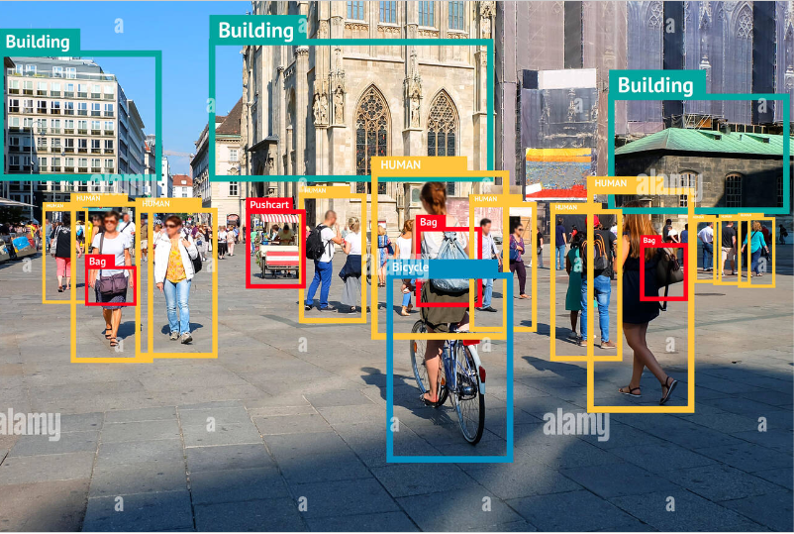
🔭WHAT IS OBJECTDETECTION?
Object detection projects leverage computer vision techniques to identify and locate objects within images or videos.
The process typically begins with the collection and annotation of a diverse dataset, where bounding boxes are marked around objects of interest, and labels are assigned. Following data preprocessing, a suitable object detection model, like Faster R-CNN, YOLO, or SSD, is selected.

Slide 5
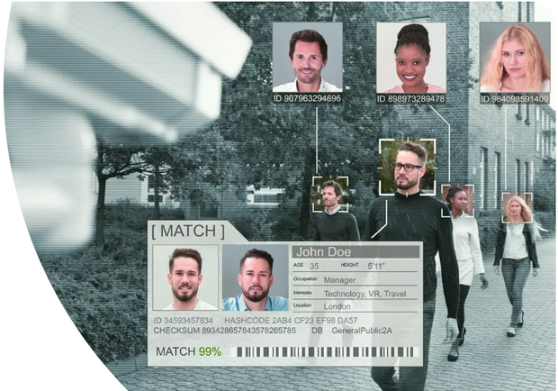
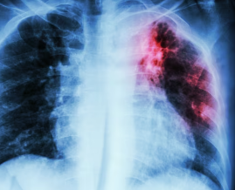
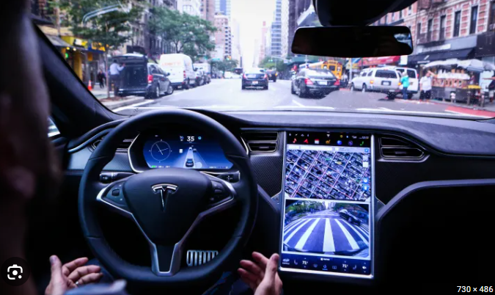
🔍APPLICATIONS :
🪪Object detection can be used to identify and track people on public transportation, helping to prevent crime and ensure passenger safety.
🏥Medical imaging: Identifying abnormalities in X-rays, CT scans, and other medical images
🚗Self-driving cars: Detecting objects on the road like cars, pedestrians, and traffic sign

Slide 6


PROBLEMS WE FACED DURING WORKING ON THIS PROJECT
The biggest problem during working on this project is that
we were doing this first time . we didn’t know so much about
objection and the computer language PYTHON in which it have to be done.
BUT WITH THE HELP OF OUR SUPPORTIVE MENTOR WE DONE THIS
PROJECT. HE HELPS US SO MUCH WHILE MAKING THIS PROJECT
WE DISCUSSED THE PROBLEMS THAT WE ARE FACING DURING MAKING
THIA PROJECT ON WHATSAPP GROUP OR IN MEETING ..

Slide 7

OBJECTIVE
The primary objective of an object detection project is to use computer vision to identify, locate, and classify objects within images or videos. The goals vary based on the application, ranging from enhancing security and surveillance to improving efficiency in areas such as autonomous vehicles, retail, healthcare, and smart cities. The project aims to leverage advanced technology to solve specific challenges and contribute to real-world applications in diverse domains.

Slide 8
🧩Implementation :-
The culmination of my exploration led me to a structured chronology of steps, facilitating a comprehensive understanding and implementation
Python Basics: Understanding the fundamentals of Python, covering essential concepts such as loops (for and while), functions, input handling, error management, and conditional statements (if-else).
Familiarization with External Libraries: Grasping the workings of external libraries and their integration within Python for enhanced functionality.
Environment Setup: Installing Python, emphasizing a stable version (e.g., Python 3.11 instead of 3.12), and PyCharm's community edition for an efficient coding environment.
Repository Initialization: Installing necessary requirements from the GitHub repository, including essential images pertinent to the project.
Implementing YOLO: Employing YOLO for the beta version of object detection. I have provided the image detection code on GitHub with detailed explanations to ensure ease of understanding.

Slide 9
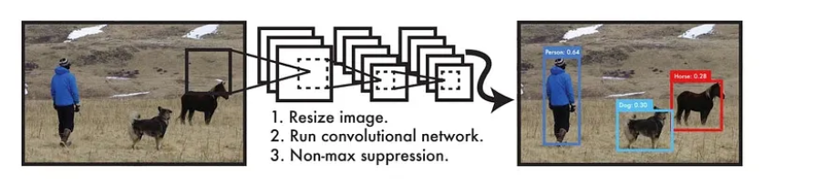
YOLOv8 for Object Detection
What is YOLO (You Only Look Once)?
YOLO (You Only Look Once) is a popular set of object detection models used for real-time object detection and classification in computer vision.
YOLO, "You Only Look Once," detects objects in images. It divides the image into grids, where each cell predicts bounding boxes & confidence scores. It then predicts class probabilities for each box. Finally, it removes redundant boxes and refines predictions for accuracy. This single-stage approach makes YOLO fast & efficient.

Slide 10
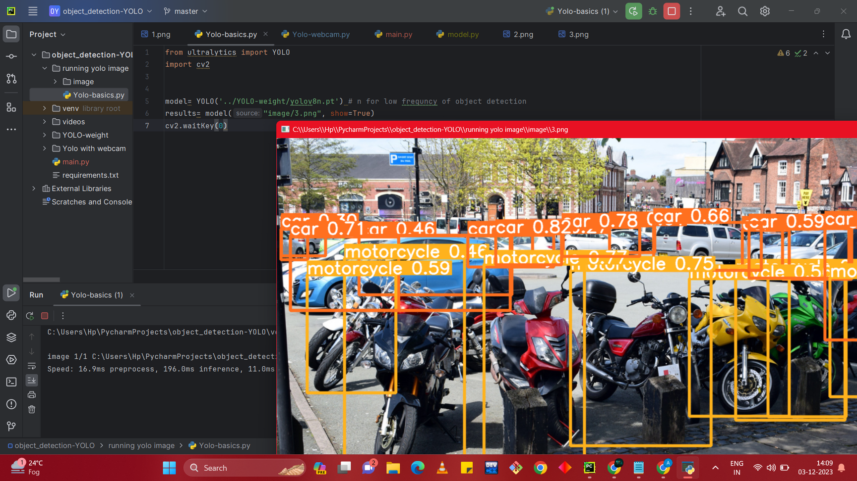
💻RESULT OF IMAGE DETECTION :

Slide 11
🧩Object detection using live webcams and videos, building upon the foundation laid during the initial phase. Here's the structured approach:
Building upon YOLO Basics: Revisiting the foundational understanding of YOLO to advance into real-time object detection.
Data Collection and Object Catalog: Gathering and installing various videos from our GitHub repository alongside a comprehensive list of objects in our surroundings essential for our detection system.
Code Enhancement and Professionalization: Providing an improved, refined version of code that facilitates real-time object detection through webcams and videos.

Slide 12
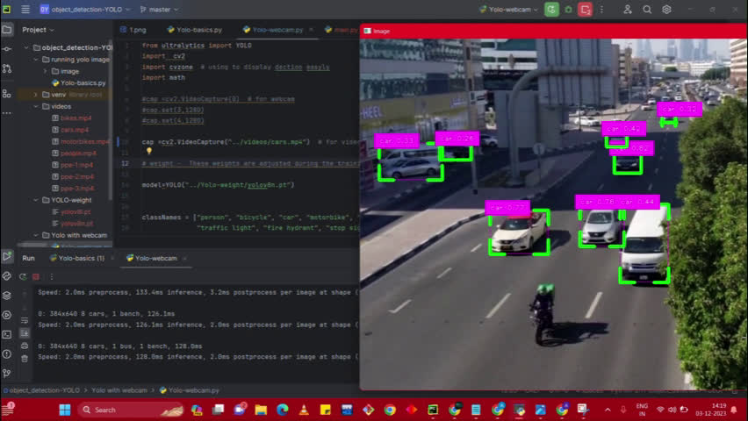

💻Result of Object detection using live webcams and videos

Slide 13


CONCLUSION
Object detection projects contribute to solving real-world challenges and have a broad impact across industries, with ongoing opportunities for innovation and improvement.

Slide 14
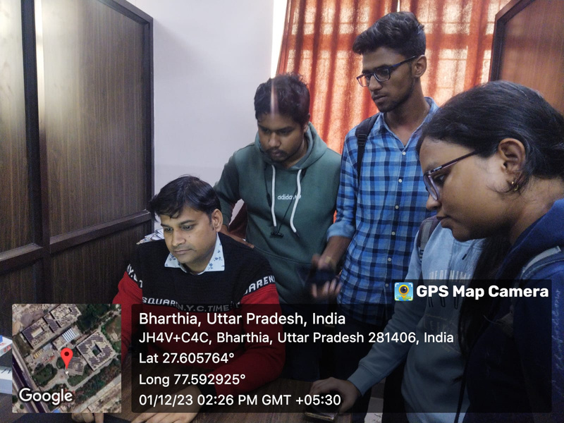
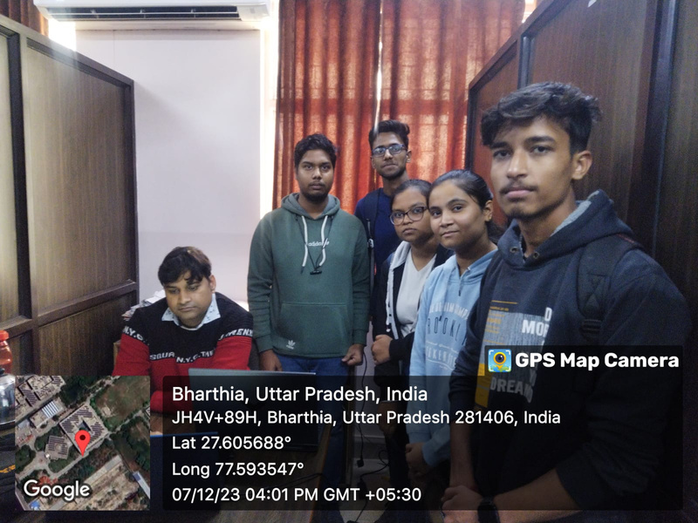
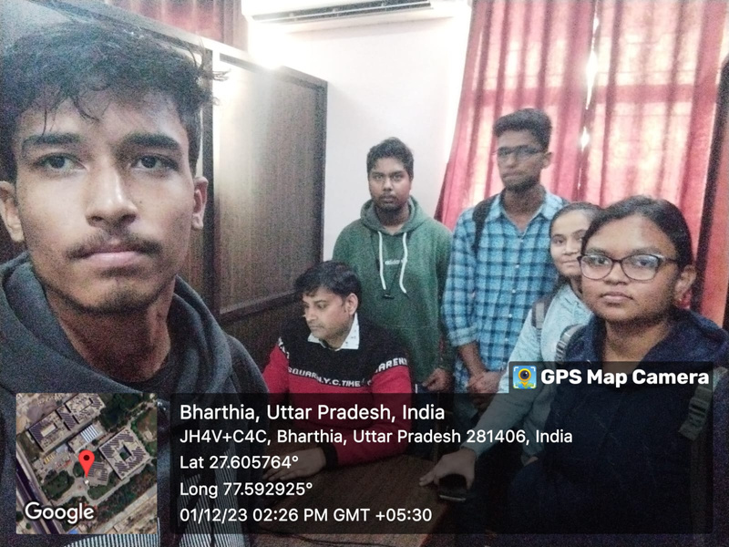
Acknowledgment
Thank you to every members of our project for contributing in this project.
specially our mentor Mr. Piyush Vashistha Sir.

Slide 15


REFERENCES
https://www.computervision.zone/courses/object-detection-course/
https://www.geeksforgeeks.org/yolo-you-only-look-once-real-time-object-detection/
https://medium.com/visionwizard/object-detection-4bf3edadf07f

Slide 16



